Slide 1

EE-464 TERM PROJECT PRESENTATION
PEAKY CONVERTERS
Çağlar Umut Özten 2375616
Onur Toprak 2375897

Slide 2
OUTLINE
TOPOLOGY SELECTION
MAGNETIC DESIGN
SIMULATIONS
CONTROLLER
COMPONENT SELECTION
AIMED BONUSES
FURTHER WORK

Slide 3
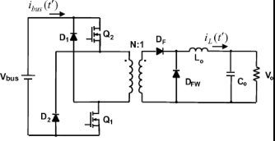
Topology Selection
TWO-SWITCH FORWARD CONVERTER

Slide 4
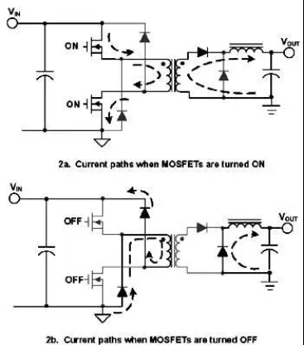
Operation Modes

Slide 5

Advantages and Disadvantages
Advantages
NO REQUIREMENT FOR RCD SNUBBER
NO REQUIREMENT FOR THIRD WINDING
HIGHER EFFICIENCY
SMALLER TRANSFORMER
LESS STRESS ON MOSFETS
LESS EMI RPOBLEM
Disadvantages
MORE COMPONENT
COMPLEX CONTROL
HIGH COST
CHALLENGES ON DISAPPEARING ENERGY ON CORE

Slide 6
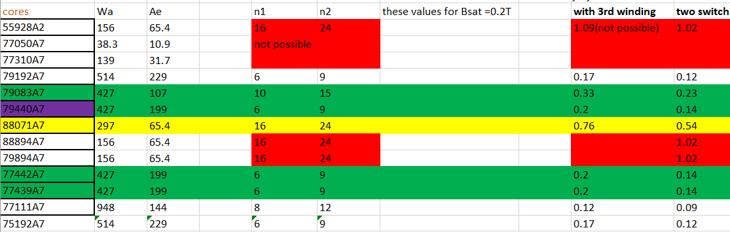
MAGNETIC DESIGN
Toroidal Cores
We realized that Lm was too small for these cores

Slide 7
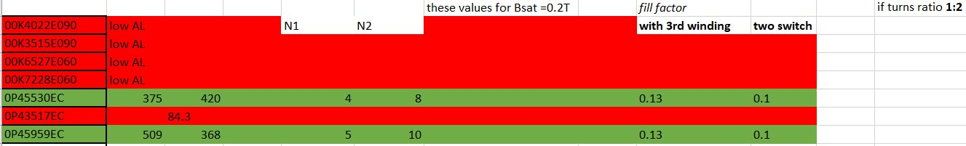
MAGNETIC DESIGN
E-CORES
Only these 2 cores have sufficient Lm
First design is with turns ratio of 2:3
After simulation, we realized it would be better to use 1:2 ratio
We will check other sources for better core utilization (fill factor)

Slide 8
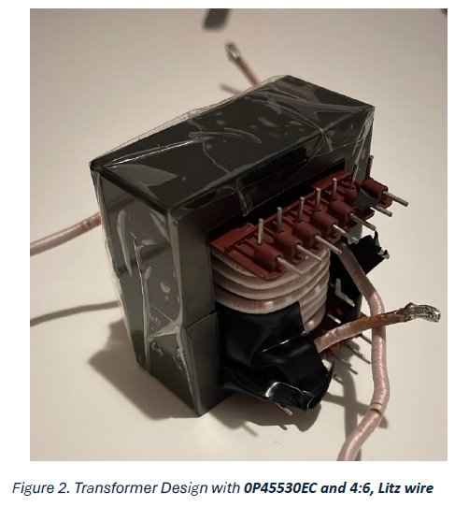
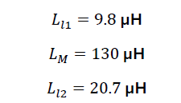
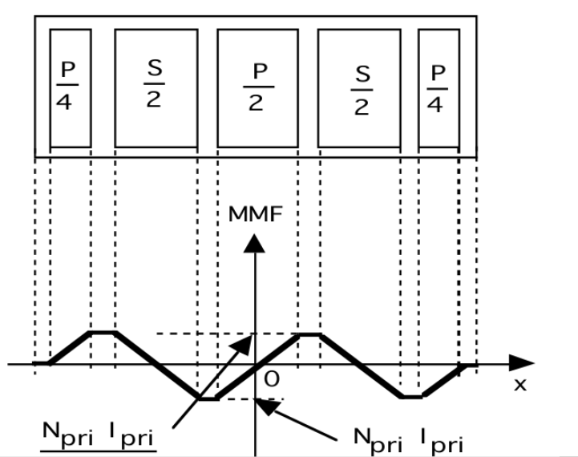
MAGNETIC DESIGN

Slide 9
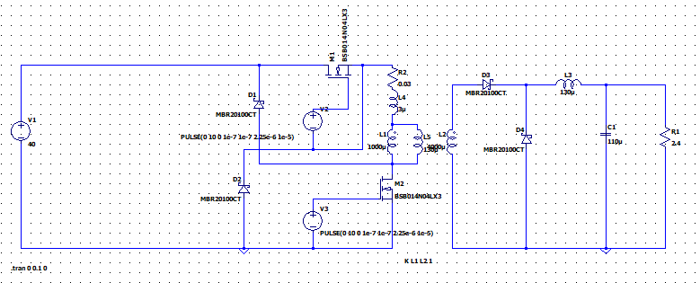
SIMULATIONS AND RESULTS
TEST SETUP

Slide 10
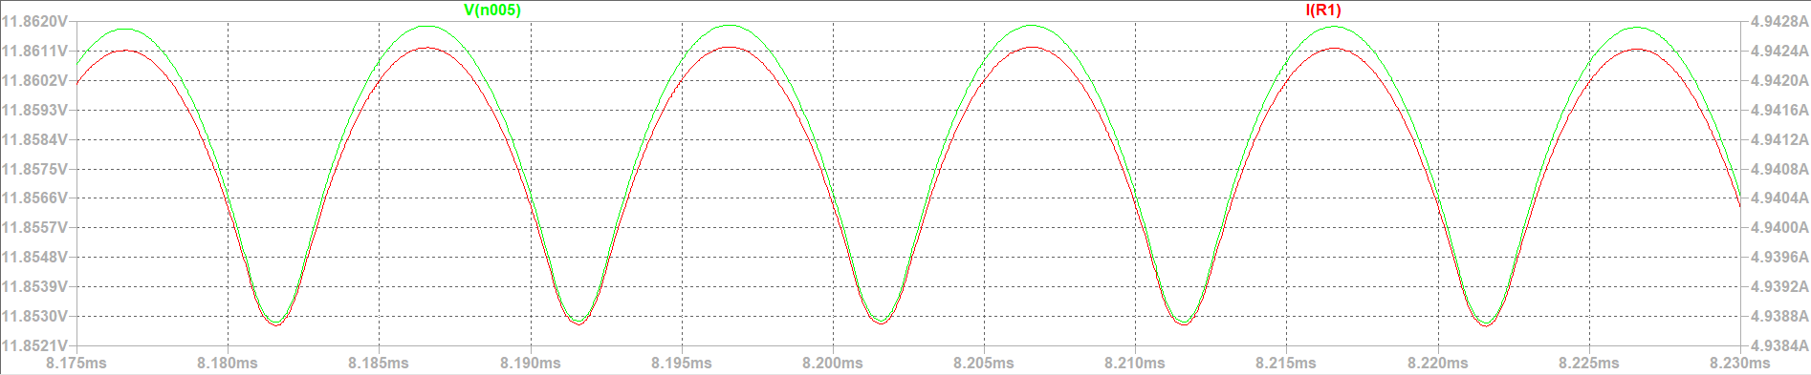
LOAD CHARACTERISTICS

Slide 11
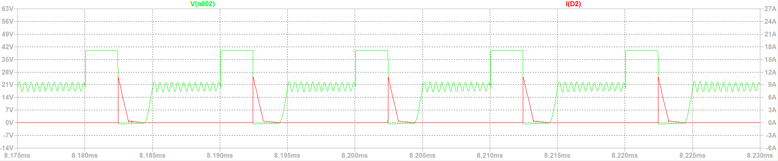
DIODE CHARACTERISTICS AT PRIMARY SIDE

Slide 12
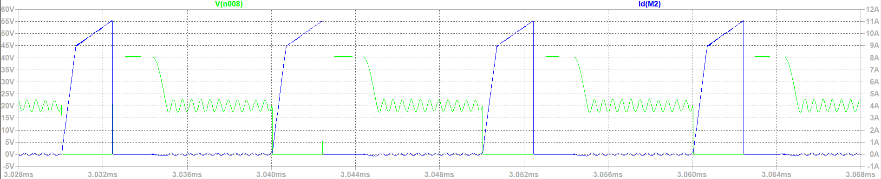
MOSFET CHARACTERISTICS

Slide 13
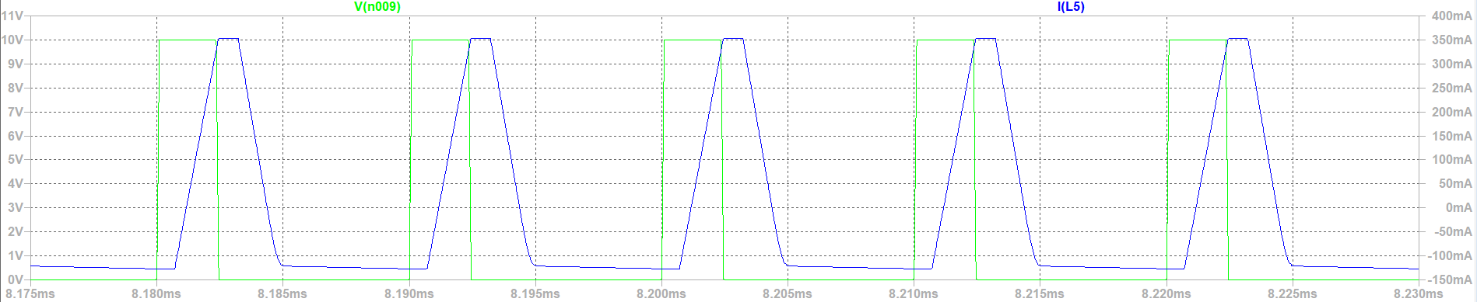
MAGNETIZING INDUCTANCE WAVEFORMS

Slide 14
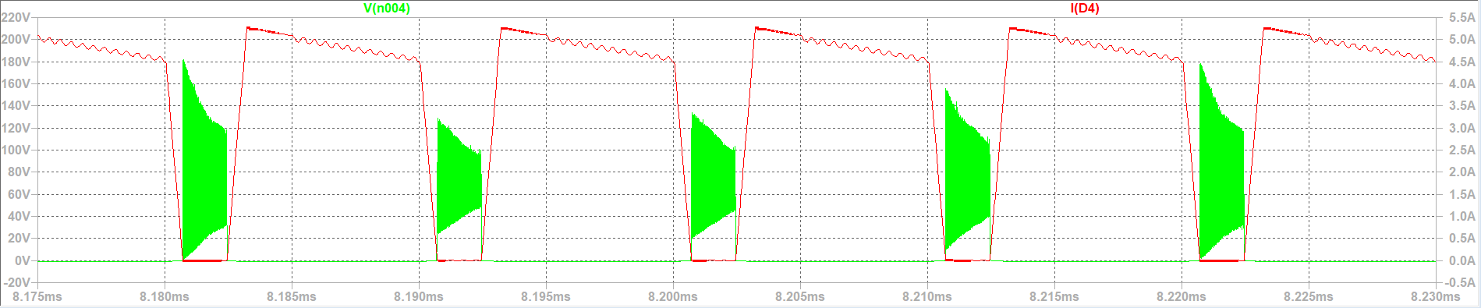
DIODE CHARACTERISTICS AT SECONDARY SIDE

Slide 15
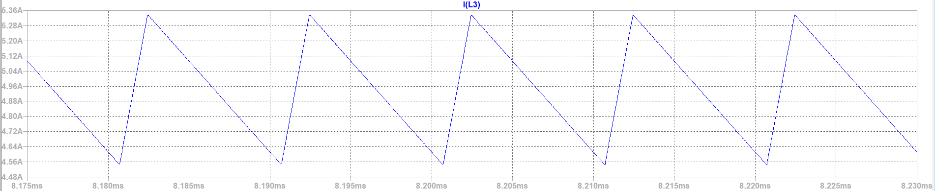
INDUCTOR CHARACTERISTICS

Slide 16
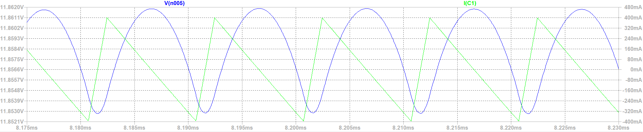
OUTPUT CAPACITOR CHARACTERISTICS

Slide 17
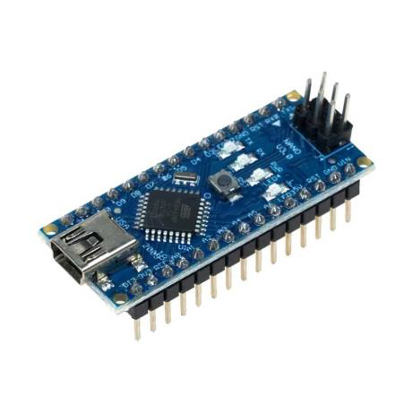
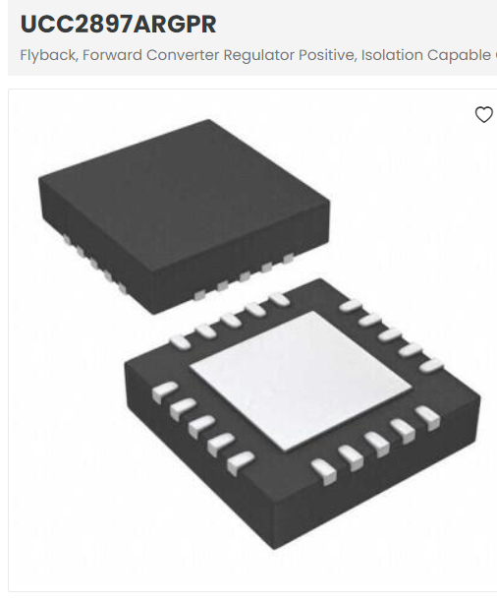
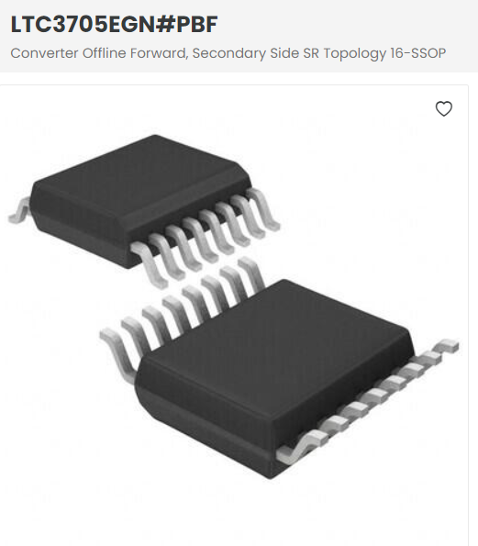
CONTROLLER
78 TL 357 TL (+driver)
First step- Digital Controller (Ardunio)
Analog Controller

Slide 18
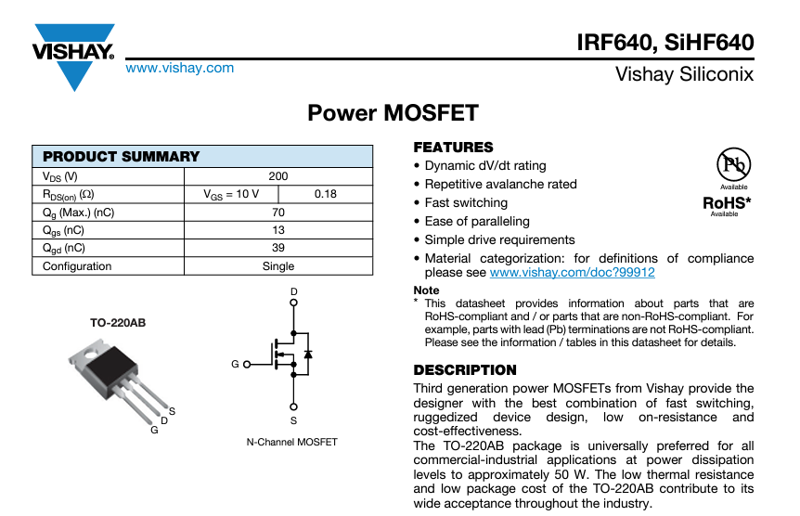
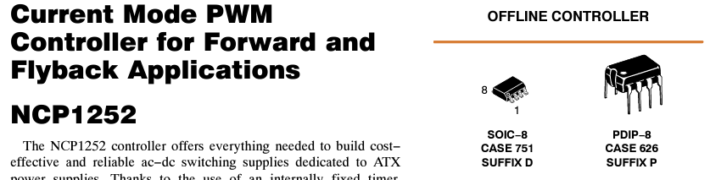
COMPONENT SELECTION
MOSFET
GATE DRİVER

Slide 19
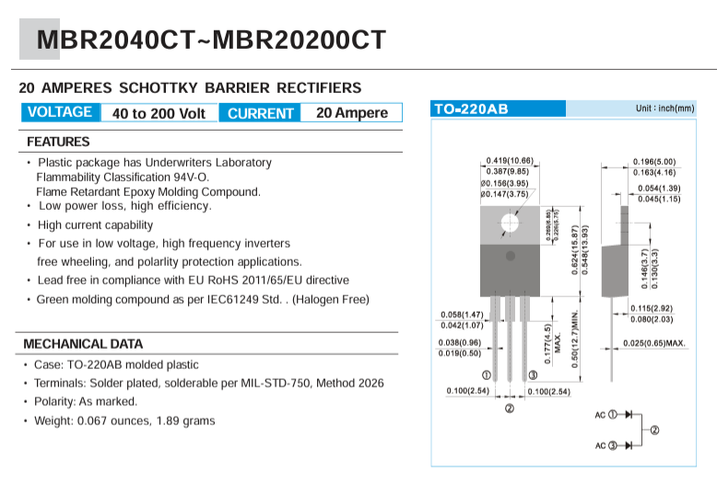
COMPONENT SELECTION
Diode
OUTPUT CAPACITOR
220 uF x2 parallel to handle current changes and regulation

Slide 20
AIMED BONUSES
DIFFERENT TOPOLOGY
PCB
ANALOG CONTROLLER

Slide 21
FURTHER WORK
Impelementation
Driver Selection
Digital Controller

Slide 22
CONCLUSION
Questions:
Any suggestion on how to discharge B during off time(avoid saturation) ?
Adding an input capacitor ?

